Slide 1
Regional Optical Conferences
12 - 22 November 2024

Slide 2
Housekeeping
Chatham House Rule​
Listen to others, and refrain from side conversations​
Photography will be taking place today – please let us know if you don’t want your photo taken
Car park – jot items down to discuss later on
Be concise, allowing everyone time to speak​
Encourage positivity​
Let people finish
Respect differing opinions

Slide 3
Fulfilling LOC needs with a transformed LOCSU
Janice Foster, CEO, LOCSU

Slide 4
Session overview
Clarity on what you can expect from LOCSU
The differences we have made already
The differences you will see in the future
How we will continue to collaborate and champion LOCs

Slide 5
Transformed LOCSU will
Lower levies
Provide clearly defined services and support
Optimise digital resources
Increase ‘commissioner influencing’ evidence for LOCs
Maximise the vital national-local conduit
Champion and showcase local innovation and LOCs

Slide 6
What LOCs can expect from LOCSU
Access to subject matter expertise
Conduit to sector bodies, OFNC and those who influence national decision makers
Promotion of LOCs and their work (including aid succession)
Strengthened communications (including LOC engagement comms)
Toolkits and guidance underpinning LOC work
Tailored LOC training and development (eye to leadership)
Clinical pathway/ enhanced service development
Data, evidence and supporting information to influence and engage ICBs
Platforms to network, share and learn (including mentor and buddy)

Slide 7
What sets LOCSU apart
Expertise and structure shaped around LOCs
Resources and team tailored to LOCs needs
Founded and formed by sector bodies
(all in your area will be members)
Unique Board providing sector rich debates on national issues impacting regional and local decisions, LOC work and primary eye care.
Unique and important role as the bridge between national and local and sector bodies
What is happening locally is escalated and debated nationally through sector bodies, and what is happening nationally is experienced and fought locally.
Central point with national overview
Data, evidence, and supporting case information, and cross-fertilisation of best practice.

Slide 8
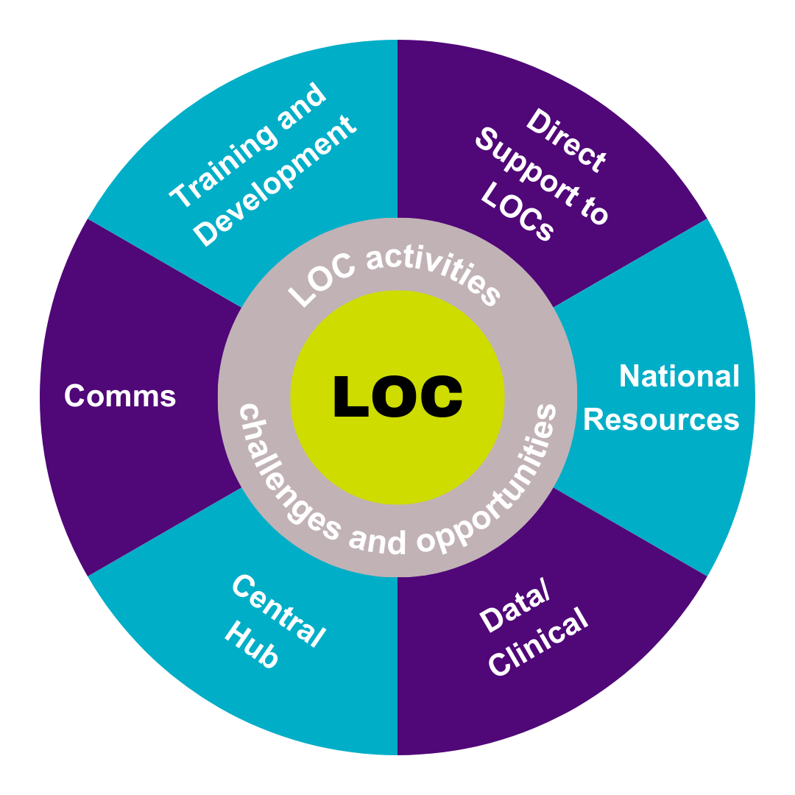
LOCSU support to LOCs
Training and Development:
CPD
Succession planning support
Committee/leadership skills
LOC induction and leadership courses
Direct Support to LOCs:
Flexible hands-on support to LOCs
ICB engagement
Payroll
Toolkits
Comms:
Promotion of LOCs
LOC Online
Fortnightly LOCSU Bulletins
National resources:
Link to national bodies
Digest of key documents
QiO
Central hub:
Networking
PCSE
Professional/legal guidance
Bids for national projects (CVD)
Data/Clinical:
Enhanced services
Information for influencing commissioners
WOPEC accreditations

Slide 9
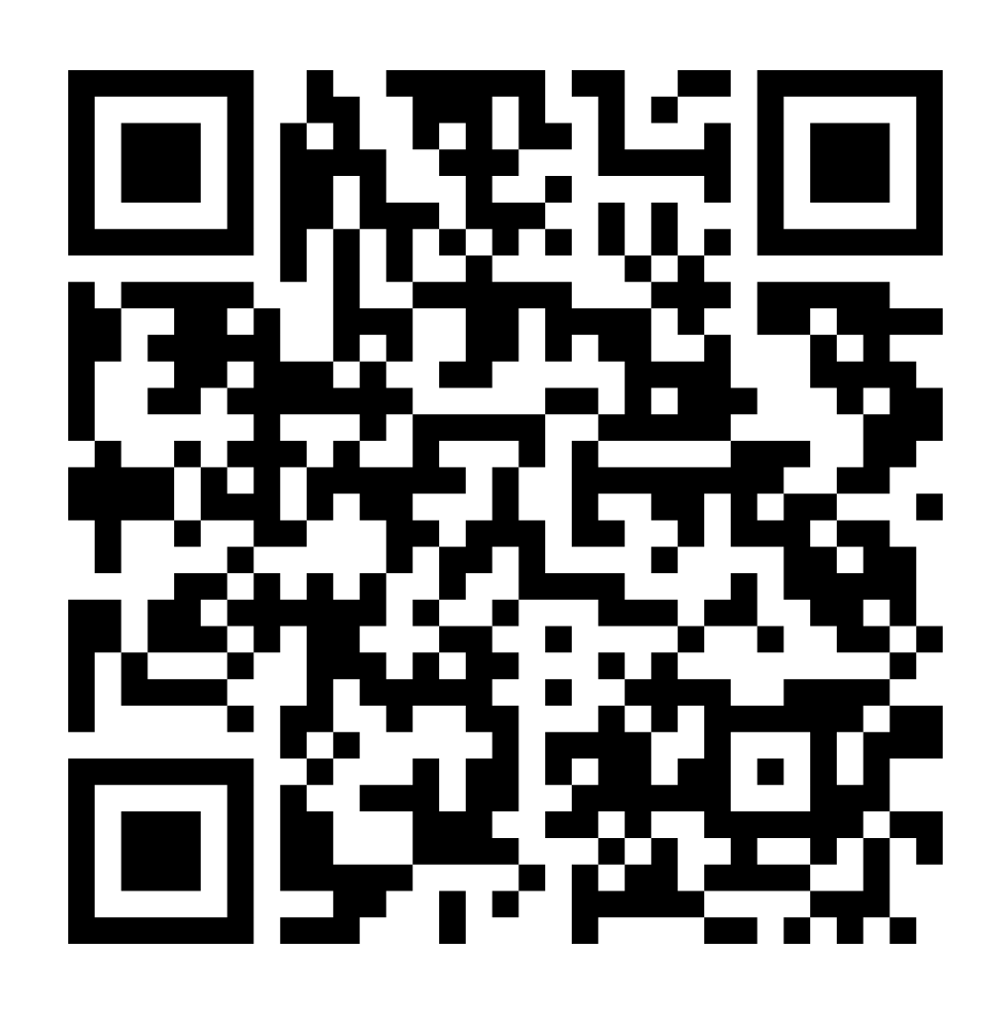
2023/25: LOCSU support to LOCs
£ increase in direct investment in LOCs, compared to the previous year
meetings to support LOC work
(average based on previous meetings attended)
CPD points issued, after expanded training offer
documents developed to support LOCs
LOCs utilising LocumKit, a LOCSU funded payroll service
LOCs have a live LOC-online website, with a further three in development
tools and support information for sharing with and influencing commissioners
accessible training and development courses for LOCs
You asked, we did
National Forum
Strengthening links and holding LOCSU to account.
Improved Communications
Improved communications, newsletters, bulletins and podcasts.
LOC Promotion
Promotion of LOCs at universities and 100% Optical (132 visitors and a third signposted to LOCs).
Plus
Standard Specification
National standard specification for CUES (community minor and urgent care) following a ministerial request.
Constitution Development
Developed with legal advice.
National conduit
OFNC and sector bodies.
Advocacy
Partnership and advocacy around Marsha De Cordova bill. All-Party Parliamentary groups, Five nations and roundtables.
NOC
Largest and most ambitious to date!
Scan to read the LOCSU Annual Report
Chair Conference/ Comms forum
Expanding the networking offer and role focused forums.

Slide 10
2025 – 2030, LOCSU will
Embrace technology and transform to maximise efficiencies and ensure expertise is readily accessible.
Collate national LOC resources, complete with data and collective learning, to support local conversations to effectively influence at a local level with national evidence and supporting cases.
Expand accessible guidance, toolkits, training and support services that underpin LOC ’business’ to make it easier for LOCs to operate and engage with constituents – we can do the heavy lifting!

Slide 11
And, LOCSU is:
Committed to the success of LOCs and contractors
Committed to utilising reserves and reducing costs (levy) to LOCs and contractors
Committed to the role of resilient, robust, and responsive support to local experts and the central conduit between national sector bodies and LOCs.

Slide 12
2025 – 2030, together we will:
Showcase and optimise local innovation, to protect and expand viable and sustainable enhanced services for the benefit of local contractors and patients.
Develop and nurture the next generation of LOC talent.
Ensure LOCs are positioned as the local, trusted authority in primary eye care, integral to local decision-making and respected for high standards, agility, and strong governance.

Slide 13
Reset
Lower levy
Clarity of activity and services
Agile and aligned to LOC and sector strategies
Accessible expertise and resources, harnessing digital technologies
Capitalise national conduit role; maximising the
LOCSU Board and LOC National and Regional Forums
to debate and strategise on issues of national,
regional and local impact.

Slide 14
Governance, Operations & Professionalism
Louise Robinson BA (Hons), MPH
Business & Operations Development Lead
Richard Edwards B.Sc. (Hons), MCOptom
Optimise Consulting

Slide 15
Session outline
Governance, Operations and Professionalism
Part one: Update on Model Constitution Framework (30 mins)
Break and opportunity to move seats if you wish
Workshop: Challenging conversations (CPD accredited – 1hrs 15mins)
Recommend to be seated by ICB
Part two: Reflections and LOC action plan (45 mins)

Slide 16
Outcomes
Improve understanding of the new Constitutional Framework
Introduce next phase of LOC consultation on outcomes from LOC working group
Improve confidence in managing Conflicts of Interest (CoI) and professional conduct concerns
Test draft content in the Constitutional Framework specific to CoI/ professional conduct
Facilitate consultation and coproduction of the new Model Constitution
Improve LOC readiness to implement new Constitutional Framework

Slide 17
Thinking about the next five years for your LOC, what are you most fearful of?
You shared that you’re fearful of:
Succession planning/attracting and engaging new members
Relationships with ICBs/not listened to by the ICB
Decommissioning of local services
Budget, financial pressures and constraints/lack of funding for training
Changes in the NHS

Slide 18
Thinking about the next five years for your LOC, what are you most excited by?
You shared that you’re excited by:
Prospect of more enhanced services
Engaging with colleagues in such changing times
Increased involvement and engagement with wider primary care systems...having a voice in local systems
Working to improve pathways/more pathways
More engagement with the optical community

Slide 19
LOC Governance, Operations & Professionalism (part one) Update on Model Constitution Framework & LOCSU support
Louise Robinson BA (Hons), MPH
Business & Operations Development Lead

Slide 20
We will explore
Why are we updating the constitution?
What problems are we trying to solve?
What would good look like?
What did we learn from the listening exercise and consultation?
How is the constitution evolving as a result?
When will the new model constitution be ready?
How will LOCSU support LOCs to adapt and adopt?

Slide 21
Baseline data
Source: Online LOC consultation survey, Spring 2024 (30 LOC responses)

Slide 22
Problems: Membership
4.1 The Committee shall consist of at least six elected members. Where practical half the elected members shall be local contractors (or their appointed representative) elected by local contractors; and half shall be local performers elected by local performers.
4.5 The Committee may co-opt up to three members who may or may not be local contractors or local performers. This should include at least one dispensing optician practicing locally who is not eligible to stand for election as a contractor or contractor’s representative.
What if we cover a small area and are not able to elect six members?
Do we have to merge with another LOC? Could co-opted roles be included in the six?
What about elected members who are both local contractors and performers? How is this measured and managed?
Can we elect dispensing opticians?

Slide 23
Problems: Terms
4.3 The term of office of the members of the Committee is three years. On the expiry of his term of office, a member is eligible for re-election.
4.4 A Chairman, Treasurer and Secretary (where a lay secretary has not been appointed) shall be elected by the committee at the first meeting following the Annual General Meeting. They shall serve for one year and be eligible for re-election. A Vice-Chairman may also be elected on the same terms.
How many terms on the committee maximum?
How many terms as an officer?
How many terms in a specific officer role?

Slide 24
Problems: Declarations of Interest
15.1 Members of the Committee shall declare any interests when standing for election and on appointment to the Committee, as well as at the start of each Committee meeting and relevant item on the agenda.
Which of the following interests should be declared?
Being married to someone who is a partner in a local IT company
Part-time employment/locum contract with an Independent Sector Provider.
Being married to a chair of a neighbouring LOC.
Owning part of a local optometry practice.
Being married to a GP practicing in the same ICB footprint as the LOC.

Slide 25
Problems: Conflicts of Interest
15.2 Members of the Committee, having an actual or potential conflict of interest in relation to an issue, shall not engage in discussion, or vote, on that issue.
What would you do in this scenario?
You notice an agenda item about deciding whether to grant an exclusive event sponsorship deal to an Independent Sector Provider (ISP) at their request. You have a part-time contract with the ISP; will you…
Wait till agenda item 4 to declare a conflict and do not participate.
Declare interest at the start; no further action needed.
Declare conflict at the start and ask the chair how to manage.
Declare conflict at the start and leave the meeting for item 4.

Slide 26
Aspiration
Create a practical constitutional framework that enables LOC members to bring their different talents and ideas to the LOC table, collaborating effectively to deliver the statutory duties of the LOC and working with other partners to help improve primary eye care provision.

Slide 27
2023/24 Listening Exercise
One size does not fit all!

Slide 28
2023/24 Listening Exercise
Committee
Roles (split/ DOs/lay)
Conduct
Complaints/ concerns
Change
Compliance
Skills (develop/ contract)
Succession
Investigation
Risk mitigation & resolution
Policies (EDI)
Boundaries/ mergers
Federation
Assurance (monitor/ report)

Slide 29
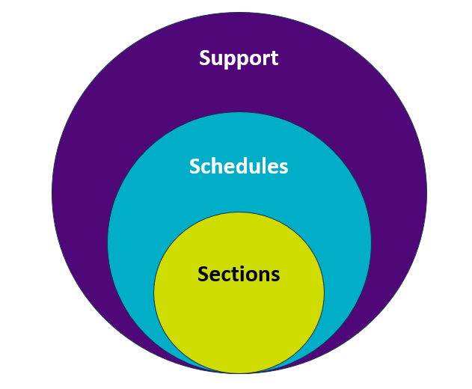
Evolution

Slide 30
2024 Online consultation

Slide 31
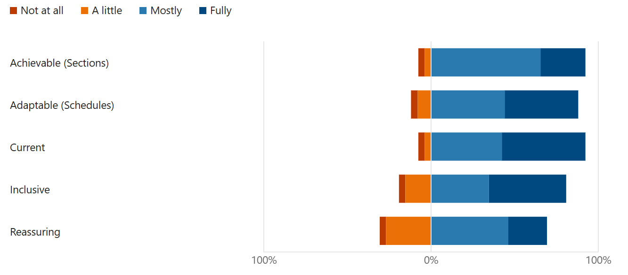
2024 Online Consultation

Slide 32
2024/25 Remaining Milestones
Winter
Finalise, launch and support LOCs to adopt and adapt (Forums & Advancement Leads)
Autumn
Consult further, co-develop and test template Schedules with LOCs (Reference Group & ROCs)
Spring
LOCs start to embed new Model Constitution with LOCSU support (AGMs).

Slide 33
Challenging Conversations Discussion Workshop
Richard Edwards B.Sc. (Hons) MCOptom
Clinical Consultant OCCS

Slide 34
CPD Objective
By the end of this workshop you should:
I have increased confidence to manage challenging conversations (Leadership & Accountability)
Be clear about why its important to have challenging conversations
Gain insights into why you find conversations challenging
Be able to adapt practical and useful insights/approaches to help you have difficult conversations in any situation
Gain confidence to face into issues of poor performance

Slide 35
Having challenging conversations
What makes a conversation challenging?
What makes conversations challenging?
What aspects make it challenging for me?

Slide 36
Belief, Action, Results: A model to help us understand why we find some conversations difficult
BELIEF
Our beliefs can have a huge impact on our confidence and skills in a situation we perceive to be difficult
We can be disappointed by the results we achieve for ourselves and others – thus continuing our belief about the situation being difficult
RESULT
ACTION
We can easily get caught up by what is difficult for us and forget about others and what’s important for them
Key Messages
Beliefs are not static, they can change & develop over time
Beliefs are a choice & limiting beliefs limit our choice
Beliefs need testing & challenging
Behaviour is driven by beliefs
Effective long term change takes place at the beliefs level
Everyone has choices around their beliefs, though some are harder to confront & change than others
Everyone has beliefs

Slide 37
Having challenging conversations
Preparing myself - some preliminary questions to ask yourself:
How am I feeling going into this situation?
What’s my belief about this situation?
What do I hope to accomplish by having this conversation?
What values are important to me?
How do I want to feel at the end of the conversation?
How will I recognise if I am ‘triggered’?
What feedback do I want to give and how will I give it?

Slide 38
List of Practical Hints & Tips
Preparation for the individual and the outcome- some preliminary questions to ask yourself:
What’s my belief about the other person?
What’s my relationship with the individual – is it big enough?
How do I want the other person to feel?
What action do I want as a result of the conversation?
How will I work with the other person to achieve some resolution?

Slide 39
Calibrating your relationship with the other party
10
Breakthrough
9
Willing to be coached by you
8
Willing to be respresented by you
7
Willing to co-invent with you
6
Willing to be advised by you
Sworn Enemies
5
Will receive information from you
…
Profound Relationships
Will not receive information from you
4
…
3
Does not value your advice
…
Works at blocking what you are doing
2
1
Misrepresents you
Is working at your downfall
Breakdown

Slide 40
Having challenging conversations
Be clear about the facts – what’s fact/what’s story
Be clear about the outcome you want
Separate the behaviour from the person
Ensure the other person is prepared and understands the reason for the conversation
There may be an emotional response – think about your typical response to different emotions, e.g.
- anger – what’s the reaction, how do I feel?
- tears – what’s the reaction, how do I feel?
Rehearse the conversation with a peer if necessary

Slide 41
The art of giving great feedback
What makes feedback effective?
Effective
Objective
Well planned –flowed well
Balanced
Authentic/credible
Motivation
Helpful
I recognised it
Gave me something tangible to focus on & improve
Built on good relationship
Ineffective
Subjective
Unplanned
Judgemental
Insincere
Unhelpful
No credibility/no respect for the coach
Felt very one way-I didn’t recognise it
Wrong time wrong location-confidentiality etc

Slide 42
A simple model for effective feedback: 4 questions & 3 statements
Questions from Coach to Coachee:
1 Can you talk me through which aspects went well?
2 Which aspects where tricky?
So what do you think you would do differently next time?
Would you like some feedback from me?
What I thought you did well …
What I thought was tricky …
What I think you may want to do differently next time…

Slide 43
During the conversation
During the conversation:
Remind the individual of the reason for the conversation
Listen
Focus on what’s being said
Don’t get defensive, antagonistic or judgmental
Make sure your message and what you want is clear
Tune into the signals the other person might be exhibiting and respond to these, don’t plough on regardless – there may be some things not being said or expressed
Take a break if need be

Slide 44
At the end of the conversation
At the end of the conversation:
Agree and confirm the next steps, timescale etc if appropriate
Seek commitment and engagement to next steps
Remember:
Keep your goals realistic. Eliminating all fear and anxiety completely from having a challenging conversation is unrealistic
Reducing anxiety levels, and learning how to manage your emotions is much more obtainable
What follow up you need to do will depend on how the conversation has gone.

Slide 45
Putting in Practice – Having a challenging conversation
Learning objective: to give you the opportunity to address a real example and get support from others in coming up with a plan to address having a difficult conversation
Working in 3s -
Everyone takes a turn at:
Practicing having a challenging conversation (a behavior rehearsal for a ‘real life’ situation)
Acting as the recipient to bring the behavior rehearsal to life
At observing and giving feedback to the individual
3 x 10 minutes
Share insights and chosen actions in the group
Individual practising (Mentor/Supervisor)
Observer
Individual recipient (student)

Slide 46
Putting in Practice – Having a challenging conversation
Observer’s prompts:
Notice:
What’s being said.
The way in which the message was communicated.
The responses to what’s being said.
The impact on the individual.

Slide 47
Case 1- Comfort Zone
You are a practice owner/manager and receive the following complaint:
I wish to complain about your optometrist Mr Edwards. When I saw him last year he told me I had early cataracts but that it wasn’t ready for the NHS to do anything and that we should leave alone and monitor.
I still drive and although my vision is ok for driving I do find my close work difficult when sewing (my hobby).
Anyway I went to visit my friend Doris who lives in another part of the country and she was telling me she had early cataract and her optometrist referred her straight a local private hospital where her cataracts were done straight away on the NHS. I want to know why Mr Edwards would not refer me when my vision was as bad as Doris and she has had her operation straight away
When I came back to your practice and asked Mr Edwards why he didn’t refer he was rude and dismissive and told me he had done nothing wrong.
BCVA 6.7.5 R&L. 6/6- Bin. Cataracts advised

Slide 48
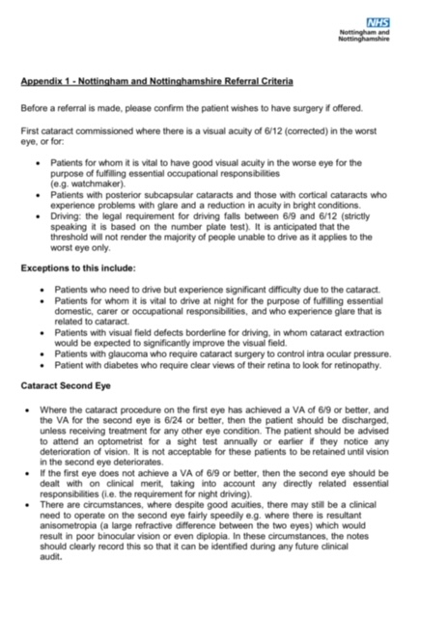

Slide 49
Case 1 Discussion
How will you manage this?
Conversations with complainant
Conversations with the registrant
What are the key insights/learnings from this case?

Slide 50
Case 1 Discussion
How will you manage this?
Conversations with complainant
Conversations with the registrant
What are the key insights/learnings from this case?
What if the clinician wasn’t working to the local protocol?
What if that was a repeating pattern?

Slide 51
Let’s start with an area in which we should be relatively comfortable… a complaint about a registrant in your area
Regulatory
Issue could constitute fitness to practise concern
Conduct v Competence
Repeating pattern of behaviour
Lack of insight
Litigation
Damage caused
Not indicative of systematically poor performance
Consumer Complaint
Explanation
Refund / low level goodwill offer
Able to resolve through mediation

Slide 52
AERO Approach: Maximising chance of resolution
Facts
Apologise
Explain
Reassure
Own it!

Slide 53
Albert Mehrabian’s work
How we influence others:
55% body language
38% tone of your voice
7% words used
Be cognisant of HOW you show up in the meeting
(Also plan when and where to meet)

Slide 54
Case 1 Discussion
How will you manage this?
Review records & confirm local pathway criteria
Plan conversation-feedback model
Structure response around AERO
What are the key insights/learnings from this case?
Know your local criteria
Be confident in applying local criteria
Politely implement AERO-communication is key
What if the clinician wasn’t working to the local protocol?
What if that was a repeating pattern?

Slide 55
Case 2
It is brought to your attention, that a fellow LOC member was asked by their employer to attend a primary care event on work time and represent their employer, however, the LOC member also claimed expenses and time allowance for a day of LOC work to attend this event.
The whistleblower, a work colleague of the committee member, wishes to remain anonymous and has provided documentary evidence. This information checks out to be correct; the LOC did not ask the member to attend on their behalf in advance. The claim has been submitted. The member is 6 months into role and this is their first claim. You have an expense policy which you check and consider is open to interpretation.
Part 1: As an LOC how would you manage this concern?
Map out your process
Part 2: Role play the conversation

Slide 56
Discussion
Refer to your constitution and identify how this behaviour constitutes a breach
Establish the facts and take a statement from the ‘whistleblower’
Formally interview the LOC colleague (representation etc.)
Document all of your findings
Would you view this differently if it was a one-off vs repeating pattern?

Slide 57
Case 3
Your LOC is at a key point in supporting the ICB with implementing their eye-care strategy, critical to this is a new CUES service. Your LOC is represented on the ICB working group by two officers*.
One of the officers has just secured a role with a third-party provider that delivers CUES in a few nearby areas and is likely to tender for the new service. The officer has expressed they wish to continue representing the LOC on the working group as they believe there is no conflict of interest.
Part 1: As an LOC how would you manage this?
Map out your process
What options are available - what are the positive/negative impacts of each option
Part 2: Role play the conversation with the officer
*Officers are LOC members with specific roles such as chair/ secretary/ treasurer/ a vice role.

Slide 58
Case 3 Discussion
Scope the options
Full recusal
Partial recusal
NDA
How would you manage the process
Plan the conversation
Role play the conversation

Slide 59
Summary & Top Tips
Don’t delay
Plan the conversations - where when how I want it to flow-take advice from LOCSU
Use the new constitution
Use ‘BAR’ to get in right mindset
Structure these conversations
Outline the issue and seek their perspective
Be clear about what happens next
Practise/sense check with a peer or colleague
Follow up to confirm changed behaviour if necessary

Slide 60
Q&A
Louise Robinson BA Hons MPH
Richard Edwards B.Sc.MCOptom
Richard.Edwards@optomiseconsulting.co.uk
07743 382552

Slide 61
Part two
Louise Robinson BA (Hons), MPH
Business & Operations Development Lead

Slide 62
Model of critical reflection
So what?
Now what?
What?
Rolfe et al 2001

Slide 63
We will explore…
What are the flexible clauses (across the whole draft constitution) and to what degree do they accommodate the different LOCs and how they operate, or wish to operate in the future?

Slide 64
Groupwork: Constitution & implementation
Working through the handout of key clauses extracted from the draft constitution; discuss whether there is enough flexibility to accommodate how your LOCs operate or wish to operate.
Work through the handout, marking any changes that would be necessary to accommodate your LOCs.
(20 minutes)

Slide 65
Thank you
Richard Edwards B.Sc. (Hons), MCOptom
Optimise Consulting
Louise Robinson BA (Hons), MPH
Business & Operations Development Lead

Slide 66
Closing remarks
Janice Foster, LOCSU CEO

